Slide 1
Pathophysiology & Classification
Thalassemia

Slide 2
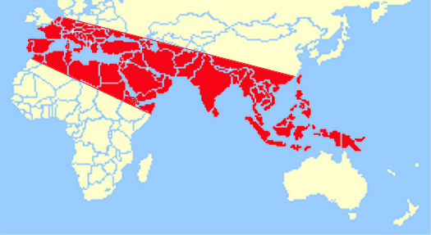
Beta-thalassaemia is a global disease - most prevalent in South Asia, the Far East, the Middle East, and Mediterranean countries.
Distribution is attributed largely to natural selection of heterozygote carriers because of protection against falciparum malaria.

Slide 3
Size of the thalassemia burden

Slide 4
Globin variants: 4.83 % of the global population carry globin variants. Worldwide birth rate of people with symptomatic globin disorders is 2.4 per 1000 births.
Thalassemia: ~ 1.5 % = 80-90 million people carry beta thalassemia trait (2010). It is estimated that >40,000 babies with beta-thalassaemia are born each year. A large proportion of these live in resource-constrained countries.
1.92 % carry sickle hemoglobin, and 0.95 % carry Hb E
Thalassemia carrier prevalence in India & Bangladesh is 3-8%.
In Bangladesh, About 10 million (one crore) people carry abnormal Hb and about 7 thousand babies are born every year with Thalassaemia.

Slide 5
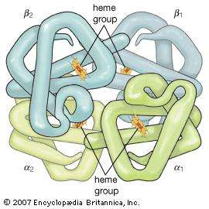
Hemoglobin Structure
Each RBC contains ≈ 270 million Hb molecules.
4 heme groups surrounding a globin.
Heme = Porphyrin attached to iron.
4 iron atoms in each molecule of Hb bind 4 atoms of oxygen.
Globin = 2 α chains of 141 amino acid & 2 β chains of 146 amino acid residues. 4 chains are packed together to form a 3 dimensional tetramer.
A heme group is attached to each of 4 chains at histidine residues.

Slide 6
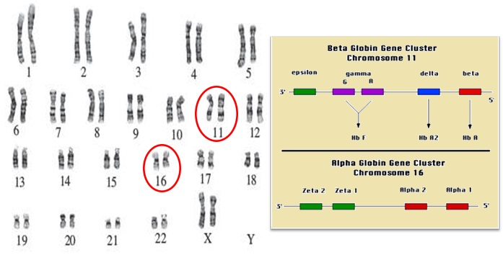
Chromosomes /genes involved in globin chain production
Beta globin is produced by the HBB gene located in beta globin locus on position 15.5 on short arm of chromosome 11.
Alpha globin is produced by genes HBA1 & HBA2 located on position 13.3 on short arm of chromosome 16.
Genetic mutation (changes of nuclotide sequence) of HBB, HBA1 or HBA2 can hamper the production of normal globin chains and result in Thalassemia.

Slide 7
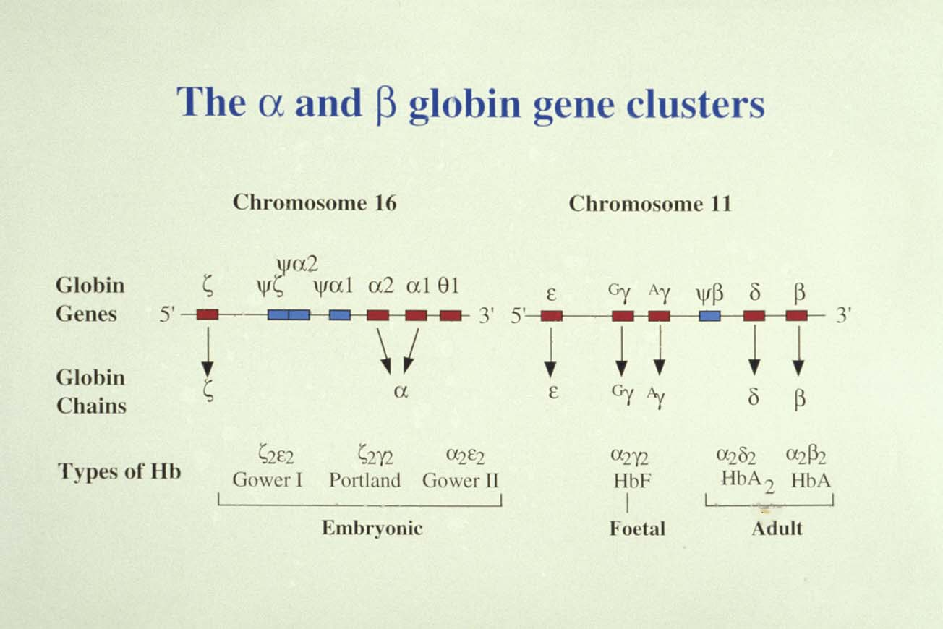

Slide 8
Globin chain production in development
α
α
50
40
γ
β
30
% of total globin synthesis
20
ζ
10
ε
β
γ
δ
12
24
36
12
24
36
48
Age post-conception
Age after birth
weeks
Birth

Slide 9
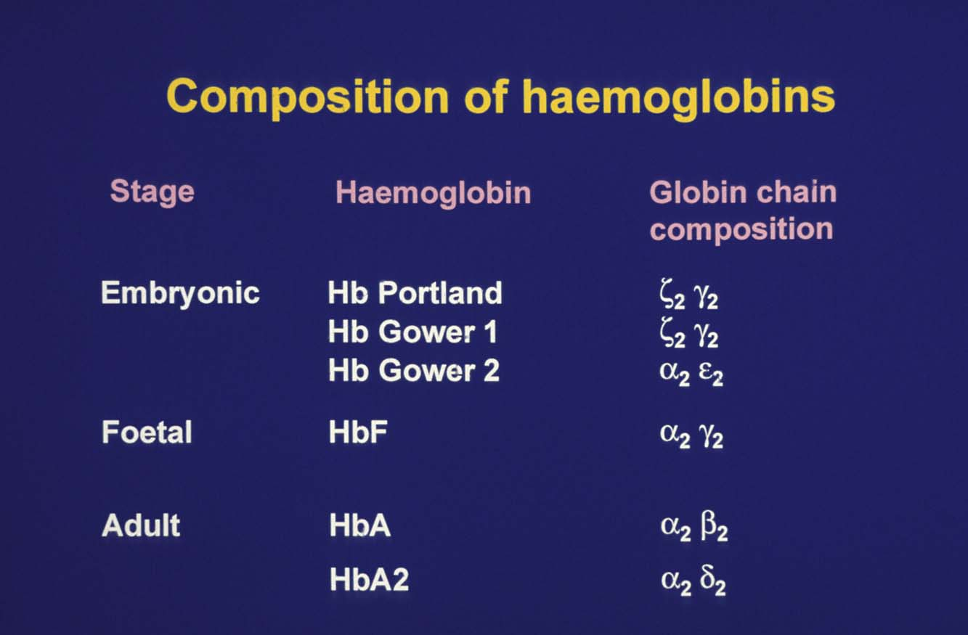
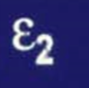

Slide 10
Normal Hb
Normal Hb in adults contain:
    HbA: 95%-98%;
    HbA₂: 1.5%-3.5%;
    HbF: <2% (<1%)
HbF:
  Normal in fetus;
  >75% of the Hb of the newborn is HbF;
  By age 2 to <1%.
  If present in >2% in adults, it is abnormal.
  Increases up to 10% during normal pregnancy.

Slide 11
Abnormal Hb
(Inherited Hb Disorders)

Slide 12
Inherited disorders of globin = Haemoglobinopathies
Variant haemoglobins: Structurally abnormal α or β proteins
Thalassaemia syndromes – Normal structure but diminished or absent synthesis resulting in altered α / β proteins
Some mutations may cause abnormalities in globin structure and also affect their production.

Slide 13
Variant Hb
Structural abnormalities in globin chains resulting from a single gene defect at either α or β loci.
Mutations change a single amino acid building block in the subunit.
Most commonly innocuous - no Hemoglobinopathy.
Occasionally, alteration of a single amino acid dramatically disturbs the behavior of Hb molecule producing a disease state - these are hemoglobinopathies. HbE, HbS, HbD
In most cases inherited as autosomal co-dominant traits.

Slide 14
Variant
Hbs
Hb Kansas
Hb S
Hb C
Hb E
Hb D-Punjab
Hb O-Arab
Hb G-Philadelphia
Hb Hasharon
Hb Lepore
Hb M
Hb Hope
Hb Pisa
Hb J
Hb N-Baltimore

Slide 15
HbE
Hemoglobin E (HbE) is an abnormal Hb with a single point mutation in the β chain. At position 26 there is a change in the amino acid, from glutamic acid to lysine.
Hb E trait
Hb E disease
Hb E/β- thalassemia
Hb sickle E disease

Slide 16
What is Thalassemia?
A group of blood diseases characterised by decreased or absent synthesis of normal globin chains.
According to the chain whose synthesis is impaired, the thalassaemias are called α-, β-, γ-, δ -, δβ-, or εγδβ-thalassaemias.

Slide 17
Types of Thalassemia
  Absent/decreased production of α-globin: α-thalassemia
  Absent/reduced production of β-globin: β-thalassemia
  Absent/reduced production of δ- or γ-globin or combined δ + β-globin subunits: Not clinically significant.
  Defective production of 2 to 4 different globin chains (δβ-, γδβ-, and εγδβ-thalassemia) are recognized: Complex thalassemias

Slide 18
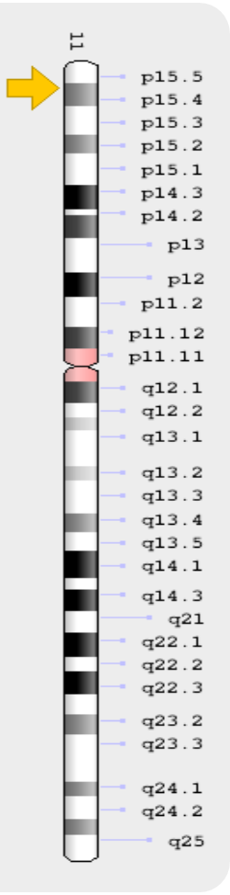
β- thalassemia
β-Thalassemias are a group of hereditary diseases caused by any of more than 200 point mutations (or rarely by deletions) of the β-globin gene, leading to low or absent production of adult β-globin and an excess of α-globin, causing ineffective erythropoiesis and low or absent production of adult Hb.
Clinically heterogeneous:
  genotypic variability variably impair globin-chain synthesis.
  genetic modifiers.
Disparity between genotypes and phenotypes is particularly marked in thalassemia intermedia and HbE thalassemia.

Slide 19
β- thalassemia
Equal numbers of Hb alpha & beta chains are necessary for normal function. Hb chain imbalance ie, altered ratio of alpha/Beta proteins destroys red cells thereby producing anemia.
Although there is a dearth of the affected Hb subunit, the few subunits synthesized are structurally normal.

Slide 20
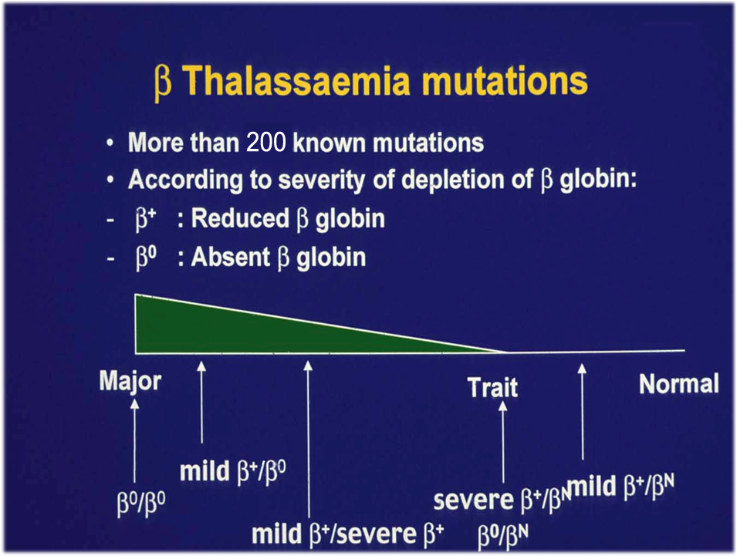
Beta thalassemia major Thalassemia Intermedia Beta thalassemia minor

Slide 21
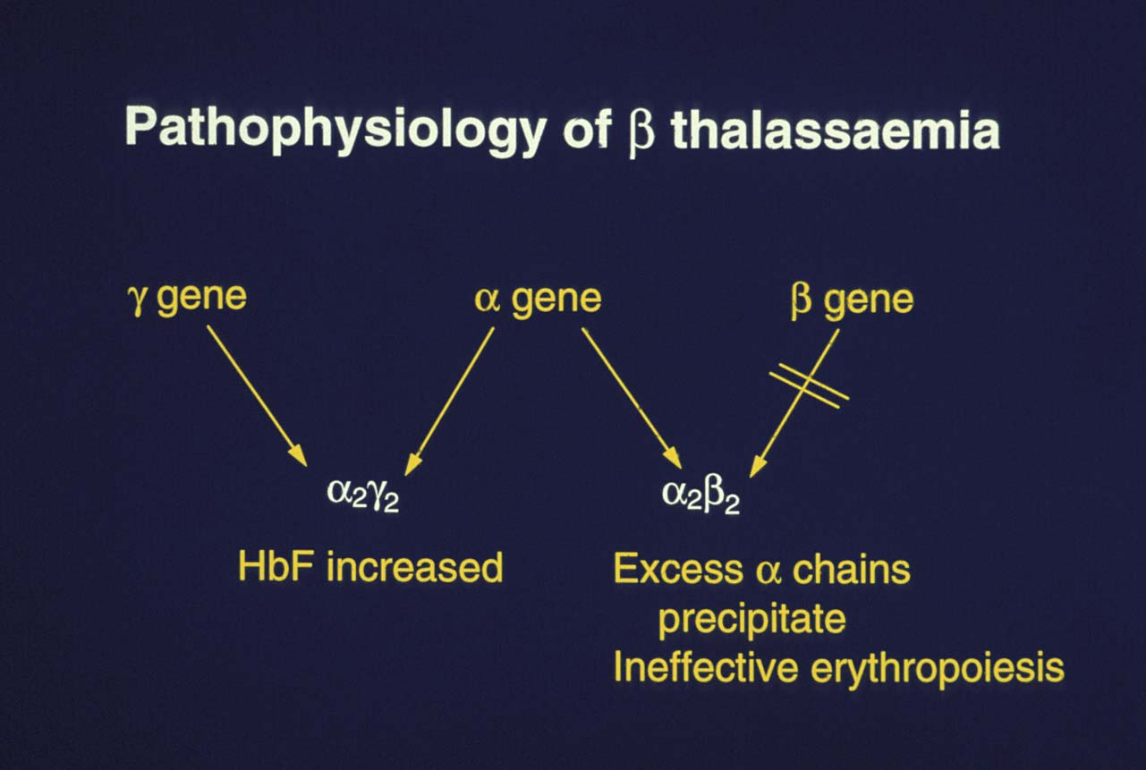

Slide 22
Classification of
Beta-Thalassaemias
Traditional - based on clinical severity: major, intermedia, or minor.
Now – based on transfusion requirement: Transfusion-dependent thalassaemia (TDT) or Non-transfusion-dependent thalassaemia (NTDT).
TDT patients require regular transfusions for survival, starting before age of 2.
NTDT patients may need transfusion therapy occasionally or for limited periods of time, especially during periods of growth and development, surgery, or pregnancy.
Transfusion is also offered to patients with NTDT to prevent or manage disease complications.
Patients may shift clinically between TDT or NTDT over time. Transfusion requirements should be re-evaluated intermittently.

Slide 23
Classification of the Thalassaemias
TDT: Homozygous β⁰ Thalassemia
Compound heterogygous β⁺/β⁰
Severe E-Beta thalassemia
NTDT - β⁺/β⁺ thalassemia
- β⁺/β⁰ thalassemia
- β-thal/HbE (E-beta thalassemia)
- homozygous β- thal/HPFH
- homozygous β⁺ thal/α-thal
  (ex. β⁺/β⁺ with −α/−α, −−/αα, −α/αα, or −−/−α)
-heterozygous β-thal/ excess α genes (ex. αα/ααα)
- Dominant forms of β-thalassemia
- HbH
- E-beta thalassemia
α thalassaemia
β thalassaemia
________________________
(δβ)º thalassaemia
Hereditary persistence of fetal Hb (HPFH)
δ thalassaemia
________________________
Sickle beta thalassemia
E-beta thalassemia

Slide 24
Determinants of disease severity
Molecular factors
  inheritance of a mild or silent β-chain mutation
  presence of a polymorphism for the enzyme Xmn-1 in the
  Gγ-promoter region, associated with increased HbF
  co-inheritance of α-thalassaemia
  increased production of α-globin chains by triplicated or quaduplicated α-genotype associated to β-heterozygosity; also from interaction of β- and δβ-thalassaemia
Environmental factors may influence severity of symptoms, e.g.
  social conditions
  nutrition
  availability of medical care
Taher A, et al. Blood Cells Mol Dis. 2006;37:12-20.

Slide 25
Clinical aspect: β-thalassaemia major
Presents between 6 and 24 months with severe anaemia, mild jaundice, and hepatosplenomegaly.
Affected infants fail to thrive. Have feeding problems, irritable, recurrent fever, and progressive enlargement of the abdomen.
Patients who are untreated or poorly transfused, the clinical picture is characterised by growth retardation, pallor, jaundice, poor musculature, hepatosplenomegaly, leg ulcers, development of masses from EMH, and skeletal changes.
Skeletal changes include leg bone deformities and typical craniofacial changes: thalassaemic facie, which tends to expose the upper teeth.
If a chronic transfusion regimen is not started, patients with thalassaemia major usually die within the first few years of life.

Slide 26
β-Thalassemia intermedia
“Highly diverse” group of β-thalassemia syndromes where RBCs are sufficiently short-lived to cause anemia but not necessarily the need for regular blood transfusions.
Clinical phenotypes lie in severity between those of β-thalassemia minor and β-thalassemia major (TM).
Arises from defective gene(s) leading to partial suppression of
β-globin protein production.
Mild
Severe
Completely asymptomatic
until adult life
Presentation at age 2–6 years
  Retarded growth and development
Taher A, et al. Blood Cells Mol Dis. 2006;37:12-20.
Guidelines for the clinical management of thalassaemia. 2nd rev ed. TIF 2008.
Notes:
26

Slide 27
Clinical aspect: β-thalassaemia intermedia
At the severe end of the clinical spectrum, patients are capable of surviving without regular transfusion, but with retarded growth and development.
At the other end of the spectrum are patients are completely asymptomatic until adult life with only mild anaemia.
Leg ulcers are frequent.
In β-thalassaemia major haemosiderosis is secondary to the chronic transfusions. In β-thalassaemia intermedia iron overload is secondary to increased intestinal iron absorption.

Slide 28
Beta thalassemia intermedia (TI)
The body's attempts to correct the anaemia result in constantly activated erythropoiesis, leading to marrow expansion (hypertrophy) and extramedullary haematopoiesis (EMH).
Deformities of the bone and face, osteoporosis with pathologic fractures of long bones occur.
Formation of erythroid masses primarily affect the spleen, liver, lymph nodes, chest and spine.
TI must be differentiated from other anaemias including sideroblastic anaemia, PNH, CDA, and MDS.

Slide 29
Beta thalassemia intermedia
These patients occasionally get some other illness and present with lower Hb and labeled as Thal Major.

Slide 30
Clinical aspect: β-thalassaemia trait
also called
Thalassemia minor
OR
Thalassemia Carrier
Since the activity of the normal β gene on the allelic chromosome makes enough stable globin, under normal circumstances, β-thalassaemia trait has no important clinical effects.

Slide 31
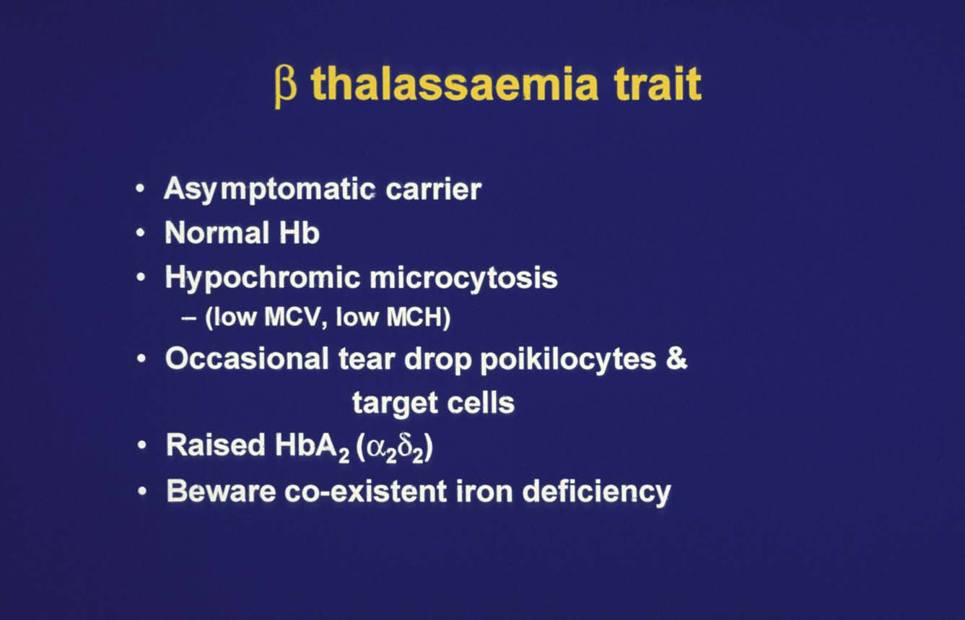

Slide 32



Former professional soccer player Zinedine Zidane
Former professional tennis player Pete Sampras

Slide 33
Summary
Because of improved child care and changing socio-economic structure; cases of adult patients with thalassemia with complications are increasing posing a management challenge for the thalassemia care givers.
Better understanding of genetic-clinical correlation help us with better management of these patients.

